Slide 1
Problems & policy options:
Reporting issues & access to information
E-PRTR Revision Impact Assessment
1st Stakeholder Workshop
15 December 2020
Mark Gibbs
Principal Consultant

Slide 2
Agenda
Introduction
Reporting modalities
Alternatives to top-down approach
Reducing reporting period
Using advanced digital technologies
Reporting issues
Tracking transfers
Inconsistencies in pollutants reported
Other sources
Diffuse sources, releases from products
Access to E-PRTR information
Improving availability, accessibility and context

Slide 3
Introduction
Problems and options for addressing when and how the data is reported and how information is made available
1. Sectors |  | 2. Pollutants / parameters |  | 3. Reporting modalities & access to information
Existing scope | No change - baseline | Existing scope | No change - baseline | Existing approaches | No change - baseline
 | Lower or no activity thresholds for specific sectors / groups of sectors |  | Lower or no reporting thresholds for specific pollutants / groups of pollutants | Top-down reporting | Selected sectors
New sectors | Different sectors | New pollutants / parameters | Different pollutants / parameters | Access to information | e.g. changes to website.
 | Different activity thresholds |  | Different reporting thresholds | Other | e.g. advanced digital technologies

Slide 4
Reporting modalities
Consider different approaches to the current bottom-up reporting by individual facilities, while adhering to Kyiv Protocol obligations
Certain sectors have many small facilities with homogenous activities but the cumulative emissions are significant
Ensure a proportionate reporting burden for the size and impact of facilities and/or sectors
Policy options:
Introduce top-down reporting for using relevant statistics for selected sectors, pollutants, and/or sizes of facilities
Mandate use of sector-specific emission factors in some cases
Applicability would depend on the potential environmental impact

Slide 5
Reporting modalities
Provide more rapid access to information by reducing the time lag between end of reporting year and availability of data
Aspirational goal of 3 months stated in recitals to the 2019 E-PRTR Commission Implementing Decision
to EEA as well as to competent authorities
Policy options:
Reduce reporting period to 3 months
Focus on key sectors/installations
E.g. where continuous monitoring already required
Encourage faster reporting for other sectors
Require simultaneous direct reporting to EEA as well as to competent authorities

Slide 6
Reporting modalities
Reporting using advanced digital technologies can enable faster submission, review and publishing of continuous monitoring data
Enhanced reporting tools could enable competent authorities to more quickly check and review submitted data
Policy options:
Mandate (near-)simultaneous reporting for certain installations where continuous emissions monitoring systems (CEMS) are used
Utilise on-line (web services) technologies to “pull” data
Clarify/codify QA/QC procedures, addressing data gaps
Develop new “joint” reporting platform that can provide data to competent authorities and EEA simultaneously
Enable parallel review processes, tracking of finalised data

Slide 7
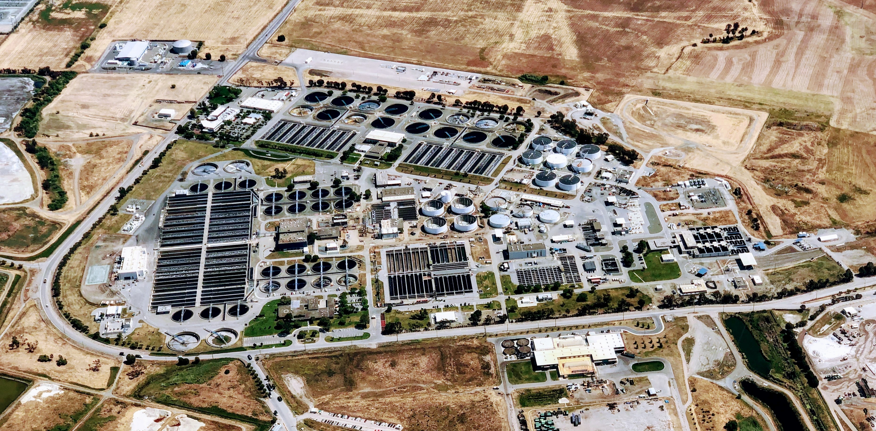
Reporting issues
Waste transfers can be double-counted
Exact destination of industrial wastewater transfers not known
Policy option:
Fully track route of waste and wastewater transfers

Slide 8
Reporting issues
Inconsistencies in pollutants reported by facilities in the same sector and in the quantification methods used
Policy options:
Integrate IED monitoring requirements in permits and align with E-PRTR reporting
Mandate reporting of expected pollutants and quantification method to be used for specific installations in permit requirements
Permit could clarify which E-PRTR pollutants are unlikely to be released in reportable quantities for that activity

Slide 9
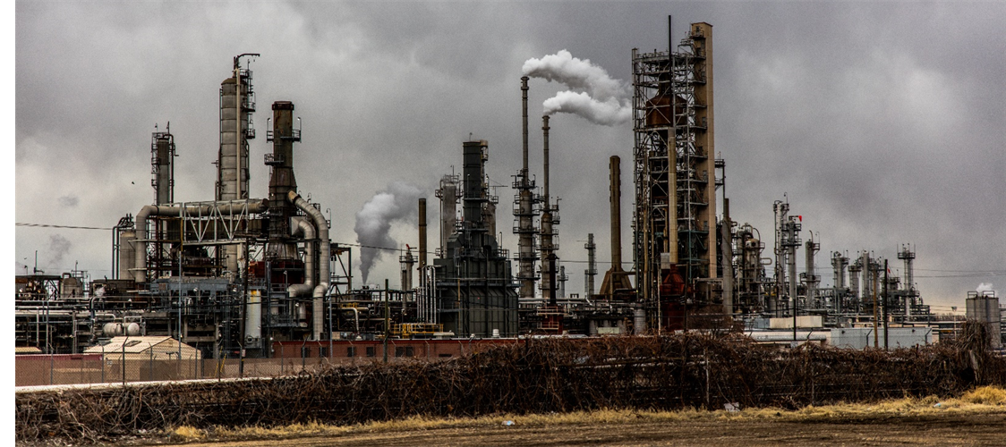
Reporting issues
No mechanism to distinguish an absence of data from misreporting – no confirmation of releases below threshold
Policy option:
Require affirmation that expected pollutants for a sector are below reporting threshold or not present at all

Slide 10
Other issues
Estimates of diffuse sources are a known area of weakness in the E-PRTR. The previous limited exercises for releases to air and water are now substantially out of date.
Needed to complete full picture of industrial emissions; very smallest facilities will likely always be below reporting thresholds
Reporting of fugitive emissions from large, complex facilities is limited
Releases from products are an increasing concern; not currently in E-PRTR
Policy options:
Conduct regular top-down assessments on a 3 or 4-year timescale
Derive information from other reporting mechanisms (NECD, WISE)
Provide clearer guidance and/or requirements for how fugitive emissions from large, complex facilities should be estimated and reported

Slide 11
Access to E-PRTR information
Public awareness and usage of the E-PRTR could be improved
Complicated dataset, requires explanation of its structure, only available in English
Lack of contextual information for comparing environmental performance and relationship to regulatory requirements researchers
Policy options:
Improve promotion of availability of the E-PRTR
Enhance website design and content, better links to national PRTRs
Provide more guidance on how to access and use the data
Provide more context to data, e.g. include resource consumption data
Case studies/fact sheets on how it has been used by MS, European agencies and institutions, NGOs and researchers

Slide 12
Thank you
Your comments will be greatly appreciated
mark.gibbs@aether-uk.com +44 1865 261466 (office)
+44 7551 978733 (mobile)

